Slide 1
Desquamative gingivitis
RUNGTA COLLEGE OF DENTAL SCIENCES AND RESEARCH,BHILAI
Dr pushpendra yadav
Sr. lecturer
Dept of Periodontology

Slide 2
SPECIFIC LEARNING OBJECTIVES
CORE AREAS | DOMAIN | CATEGORY
DEFINITION | Affective | Desire to know
HISTORY | Cognitive | Nice to know
CLASSIFICATION | Cognitive | Must to know
CLINICAL FEATURES | Cognitive | Must to know
MANAGEMENT | Cognitive | Must to know
CLINICAL EXAMINATION | Cognitive | Must to know
MICROSCOPIC EXAMINATION | Cognitive | Must to know
DISEASES THAT CAN MANIFEST AS DESQUAMATIVE GINGIVITIS | Cognitive | Must to know

Slide 3
CONTENT
PART-I
DEFINITION
HISTORY
CLASSIFICATION
CLINICAL FEATURES
MANAGEMENT
CLINICAL EXAMINATION
MICROSCOPIC EXAMINATION
PART -II
DISEASES THAT CAN MANIFEST AS DESQUAMATIVE GINGIVITIS
SUMMARY
REFERENCE

Slide 4
Diseases that can manifest as desquamative gingivitis
Lichen planus
Pemphigoid
Pemphigus
Chronic ulcerative stomatitis
Linear IgA disease
Dermatitis herpetiformis
Lupus erythematosus
Erythema multiforme
Drug-related eruptions

Slide 5
Lichen planus
Lichen planus is an inflammatory mucocutaneous disorder that can involve the mucosal surfaces (e.g., oral cavity, genital tract, other mucosae) and the skin, including the scalp and the nails.
Evidence suggests that lichen planus is an immunologically mediated mucocutaneous disorder in which host T lymphocytes play a central role.

Slide 6
occurs in 0.1% to 4% of the population.
middle-aged or older women;
2 : 1 ratio of women to men.
Children are rarely affected.
In a dental setting, cutaneous lichen planus is observed in about one-third of patients diagnosed with oral lichen planus.
Two-thirds of patients seen in dermatologic clinics exhibit oral lichen planus

Slide 7
Gingival lesions
Approximately 7–10% of patients with oral lichen planus have lesions restricted to the gingival tissue.
They may occur as one or more types of the following four distinctive patterns:

Slide 8
Keratotic lesions: The raised, white lesions can manifest as groups of individual papules, linear or reticular lesions, or plaque-like configurations.
Erosive or ulcerative lesions: The extensive erythematous areas with a patchy distribution can manifest as focal or diffuse hemorrhagic areas. The lesions are exacerbated by slight trauma (e.g., toothbrushing)

Slide 9
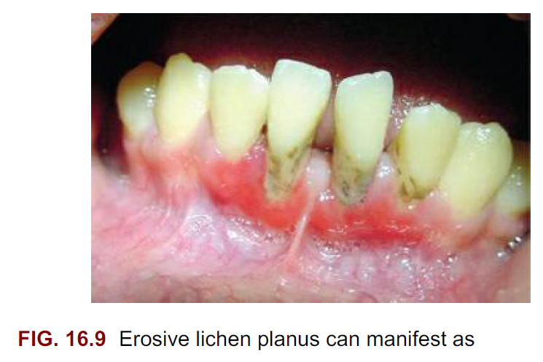

Slide 10
Vesicular or bullous lesions: The raised, fluid-filled lesions are uncommon and short lived on the gingiva, quickly rupturing and leaving ulcerations.
Atrophic lesions: Atrophy of the gingival tissues with ensuing epithelial thinning results in erythema that is confined to the gingiva.

Slide 11
Differential diagnosis
If the white striations are absent, the differential diagnosis should primarily include MMP and pemphigus vulgaris.
Less common possibilities include linear immunoglobulin A disease (LAD), lichen planus pemphigoides, and chronic ulcerative stomatitis.

Slide 12
Treatment
The keratotic lesions of oral lichen planus are asymptomatic and do not require treatment
However, evaluation of the patient every 6 to 12 months is warranted to monitor suspicious clinical changes and to look for the emergence of an erosive component.

Slide 13
PEMPHIGOID
The term pemphigoid applies to several….
cutaneous,
immune-mediated,
subepithelial bullous diseases
characterized by a separation of the basement membrane zone.

Slide 14
Bullous pemphigoid
chronic, autoimmune, subepidermal bullous disease with tense cutaneous bullae that rupture and become flaccid.
Oral involvement occurs in about a third of affected patients.
Skin lesions ……..clinically resemble those of pemphigus, the microscopic picture is quite distinct.

Slide 15
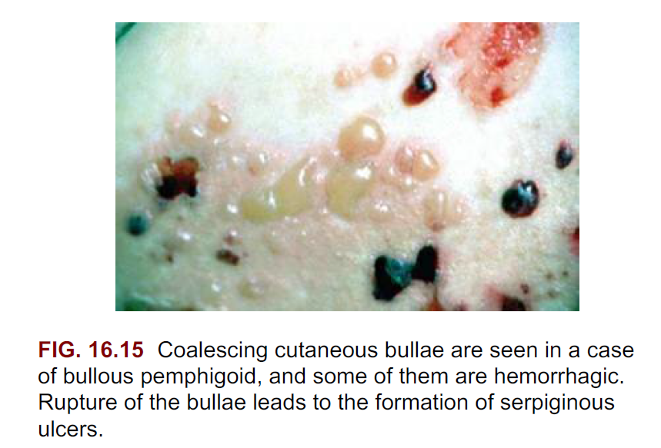

Slide 16
Treatment
Because of unknown etiology, treatment is designed to control its signs and symptoms.
The primary treatment is a moderate dose of systemic prednisone.
Steroid-sparing strategies (i.e., prednisone plus other immunomodulatory drugs) are used when high doses of steroids are needed or when the steroid alone fails to control the disease

Slide 17
Mucous membrane pemphigoid
Mucous membrane pemphigoid (i.e., cicatricial pemphigoid) is a chronic vesiculobullous autoimmune disorder.
unknown etiology
predominantly affects women during the fifth decade of life.
It has rarely been reported in young children.

Slide 18
Ocular lesions
Among patients (mainly those with desquamative gingivitis) who first see a dentist, the eyes are affected in approximately 25%.
In contrast, among patients who first see a dermatologist, 66% have conjunctival lesions;
In ophthalmic studies, 100% of patients have ocular involvement.

Slide 19
Oral lesions
The most characteristic feature of oral involvement is desquamative gingivitis, typically with areas of erythema, desquamation, ulceration, and vesiculation of the attached gingiva.
Vesiculobullous lesions can occur elsewhere in the mouth.

Slide 20
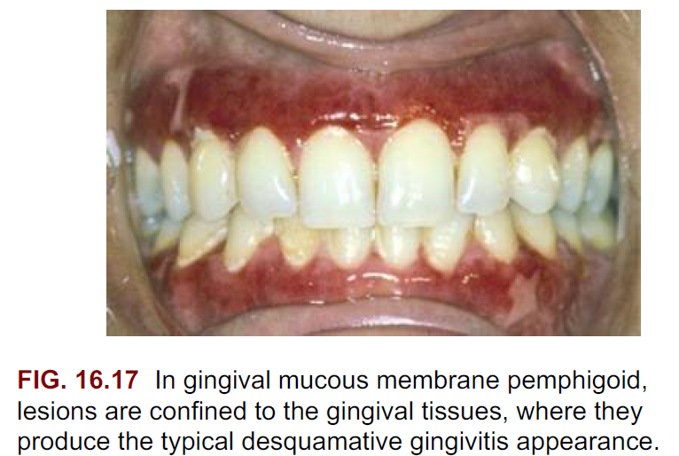

Slide 21
Differential diagnosis
Several disease entities manifest with similar clinical and histologic (i.e., subepithelial bulla) features. They include:
bullous pemphigoid,
bullous lichen planus,
dermatitis herpetiformis,
LAD,
Erythema multiforme,
herpes gestationis, and
epidermolysis bullosa acquisita.

Slide 22
Treatment
Topical steroids are the mainstay of treatment for MMP, particularly when lesions are localized.
Fluocinonide (0.05%) and clobetasol propionate (0.05%) in an adhesive vehicle can be used three times daily for up to 6 months.

Slide 23
Pemphigus vulgaris
The pemphigus diseases are a group of autoimmune bullous disorders that produce cutaneous and mucous membranes blisters.
Pemphigus vulgaris
pemphigus foliaceus,
pemphigus vegetans, and
pemphigus erythematosus

Slide 24
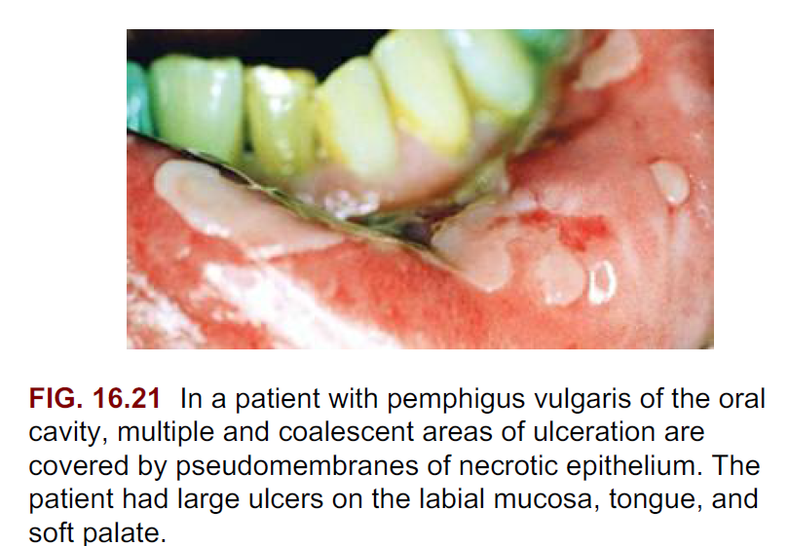

Slide 25
Oral lesions
range from small vesicles to large bullae.
When the bullae rupture, they leave extensive areas of ulceration.
Virtually any region of the oral cavity can be involved, but multiple lesions often develop at sites of irritation or trauma

Slide 26
Differential diagnosis
Erythema Multiforme…. exhibits negative immunofluorescence.
Pemphigus vulgaris- shows characteristic intraepithelial clefting at the basal–spinous cell layers and interface with acantholysis, whereas erythema multiforme-shows microvesiculation of the superficial epithelial layers and numerous necrotic keratinocytes.

Slide 27
Treatment
The main therapy for pemphigus vulgaris is systemic corticosteroids with or without the addition of other immunosuppressive agents.
If the patient responds well to corticosteroids, the dosage can be gradually reduced, but a low maintenance dosage is usually necessary to prevent or minimize the recurrence of lesions.

Slide 28
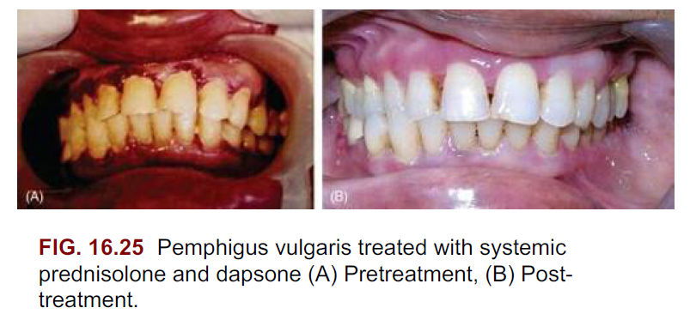

Slide 29
Chronic ulcerative stomatitis
first reported in 1990,
has a predilection for women during the fourth decade of life.
manifests with chronic oral ulcerations
Exhibits few cutaneous lesions.

Slide 30
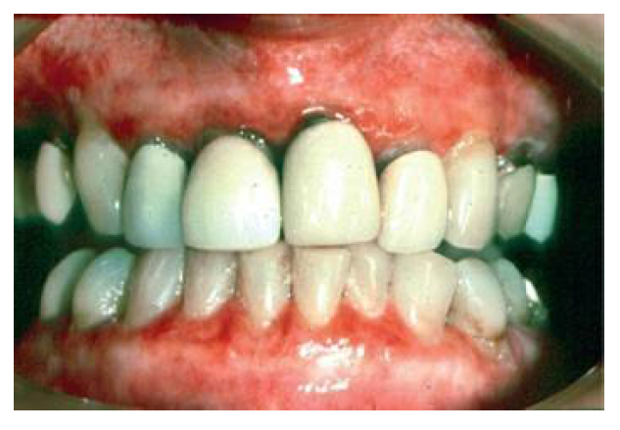
Oral lesions
Painful solitary small blisters and erosions with surrounding erythema occur mainly on the gingiva and the lateral border of the tongue.

Slide 31
Differential Diagnosis
Erosive lichen planus.
Pemphigus vulgaris, MMP, LAD, bullous pemphigoid, and lupus erythematosus.

Slide 32
Treatment
For mild cases, topical steroids (e.g., fluocinonide, clobetasol propionate) and topical tetracycline can produce clinical improvement, but recurrences are common.
For severe cases, a high dose of a systemic corticosteroid is needed to achieve remission.

Slide 33
Linear immunoglobulin a disease
uncommon mucocutaneous disorder
predilection for women.
Unknown etiology
manifests as a pruritic vesiculobullous rash

Slide 34
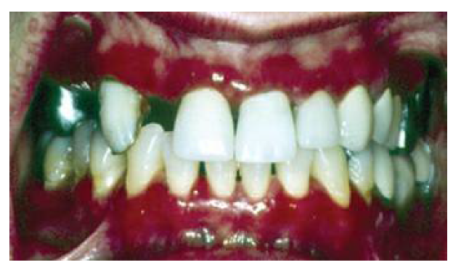
Oral lesions
consist of vesicles, painful ulcerations or erosions, and erosive gingivitis or cheilitis.
The hard and soft palates are affected more often; the tonsillar pillars, buccal mucosa, tongue, and gingiva.

Slide 35
Treatment
The primary treatment of LAD involves a combination of sulfones and dapsone.
Small amounts of prednisone (10 to 30 mg/day) can be added if the initial response is inadequate

Slide 36
Dermatitis herpetiformis
chronic condition
ages of 20 and 30 years,
slight predilection for men.
Evidence indicates that dermatitis herpetiformis is a cutaneous manifestation of celiac disease.

Slide 37
Oral lesions
range from painful ulcerations preceded by the collapse of ephemeral vesicles or bullae to erythematous lesions.

Slide 38
Treatment
A gluten-free diet.
Oral dapsone is usually needed

Slide 39
Lupus erythematosus
an autoimmune disease with three clinical presentations:
systemic, chronic cutaneous, and subacute cutaneous.

Slide 40
Systemic lupus erythematosus
10 : 1 predilection for women compared with men.
SLE can affect the kidneys, heart, skin, and mucosa.
The classic cutaneous lesions characterized by a rash on the malar area with a butterfly distribution are uncommon.

Slide 41
Differential diagnosis
Erosive lichen planus,
Erythema multiforme,
Pemphigus vulgaris

Slide 42
Treatment
The therapy for SLE depends on the severity and extent of the disease.
It can range from topical steroids to nonsteroidal antiinflammatory drugs to moderate to high doses of prednisone for severe systemic organ involvement.

Slide 43
Erythema multiforme
an acute bullous and macular inflammatory mucocutaneous disease
ages of 20 and 40 years;
it is rarely seen in children (≤20%)
Target (i.e., iris) lesions with central clearing are the hallmark of erythema multiforme

Slide 44
oral lesions
The oral lesions consist of multiple, large, shallow, painful ulcers with an erythematous border.
The lesions are so painful that chewing and swallowing are impaired.
The buccal mucosa and the tongue are the most frequently affected sites, followed by the labial mucosa.

Slide 45
Treatment
There is no specific treatment for erythema multiforme.
For mild symptoms, systemic and local antihistamines, topical anesthetics, and debridement of lesions with an oxygenating agent are adequate

Slide 46
SUMMARY
Desquamative gingivitis is not a specific disease entity but a manifestation of several disorders. Approximately 75% of the cases have dermatologic genesis. Intense erythema and peeling of the surface epithelium of the surface epithelium involving marginal and attached gingiva are the main features. Symptoms vary from mild discomfort to severe burning sensation and pain. Lichen planus, mucous membrane pemphigoid and pemphigus are the most common conditions leading to desquamative gingivitis.

Slide 47
REFERENCE
Newman MG, Takei HH, Klokkevold PR, Carranza FA. Carranza’s clinical periodontology, 10th ed. Saunders Elsevier; 2007.
Lindhe J, Lang NP and Karring T. Clinical Periodontology and Implant Dentistry. 6th ed. Oxford (UK): Blackwell Publishing Ltd.; 2015.
Newman MG, Takei HH, Klokkevold PR, Carranza FA. Carranza’s clinical periodontology, 13th ed. Saunders Elsevier; 2018.

Slide 48
THANK YOU

